Slide 1

Public Funding & Investment Strategy
(March 2024)
Speaker and Front Runner:
Ioana Dragos (NW RDA)
Hosted by Janina Belke (bwcon)

Slide 2
Agenda & Intro
Agenda & Introduction
Intro of the Front Runner
(5 min.)
Welcome
(3 min.)
Impuls
(20 min.)
Q&A Time
(15 min)
Your
Active Part
Closing
(2 min.)
Infos on Coaching Sessions
Follow up
by mail

Slide 3
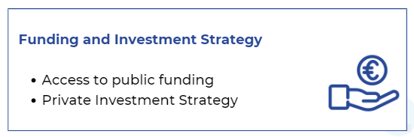
Impuls and Q&A
What questions, uncertainties or issues have arisen
in relation to Public Funding & Investment Strategy?
Topics of the recorded webinars

Slide 4
This session will facilitate understanding of the European funding system
and will ease you the access to European funding, exploring the different
programmes supporting Industry 4.0 digital solutions, manufacturing industry and research, development and innovation.
Public Funding
WEBINAR 2023 – 1 h – available to the MIND4MACHINES Acceleration Programme intranet website [ funding sources still available; funding opportunities NO, since it’s constantly changing)
Upcoming MIND4MACHINES NEWSLETTER – March 24

Slide 5
Main topic addressed:
Main EU programmes - main sources for funding opportunities
Main criteria to apply
Facilitating project partnerships
NEXT M4M NEWSLETTER:
Open & forthcoming open calls
Target group:
SMEs and large companies acting as digital providers for Industry 4.0. solutions
SMEs from manufacturing industry
R&D organisations
Main programmes financing:
Research & development & innovation
SME & startup competitiveness
Collaboration & knowledge transfer
DIRECT CALLS
HORIZON EUROPE
SINGLE MARKET
DIGITAL EUROPE
INNOVATION FUND
CASCADE FUNDING *FSTP

Slide 6
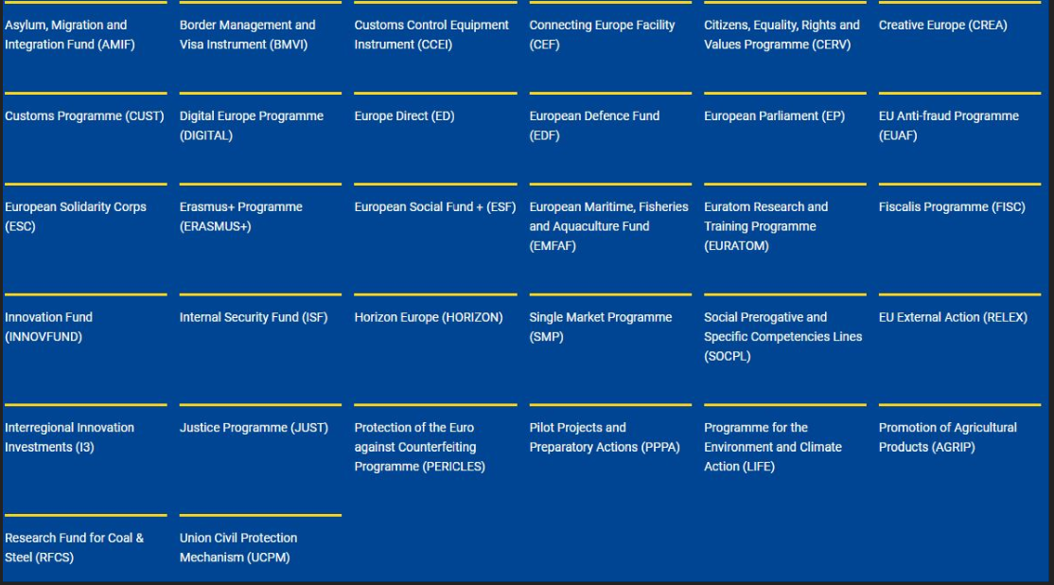
Sources – EU funding & tenders PORTAL (europa.eu) https://ec.europa.eu/info/funding-tenders/opportunities/portal/screen/home
EU Programmes
2021-2027
+ Partner search feature
for each call

Slide 7
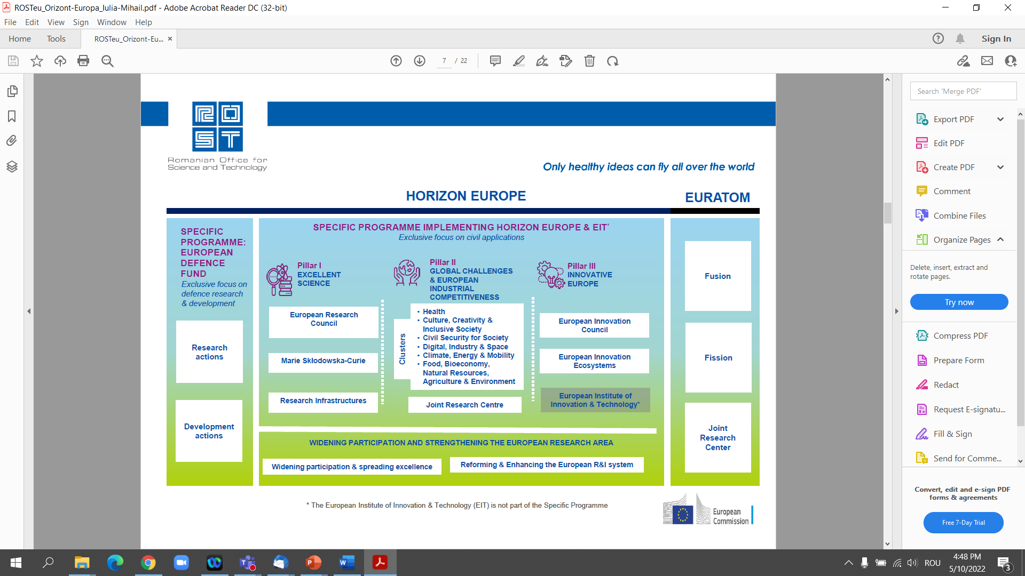
HORIZON EUROPE – Research, Development & Innovation

Slide 8
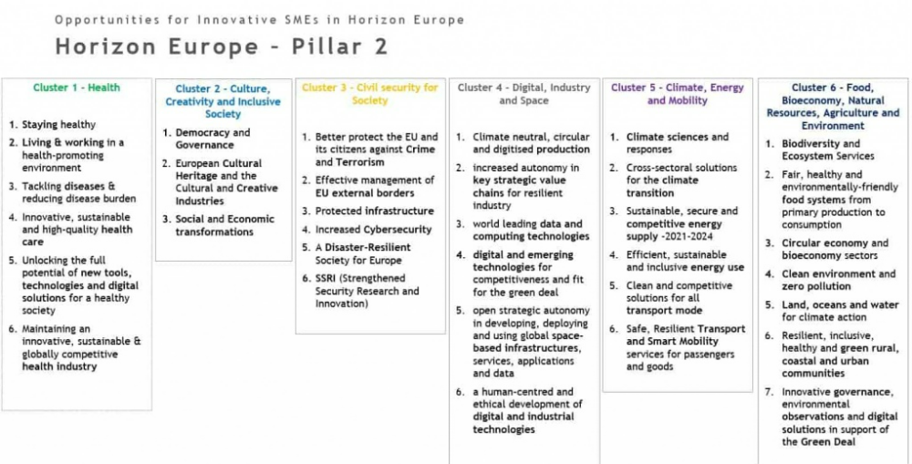

Slide 9
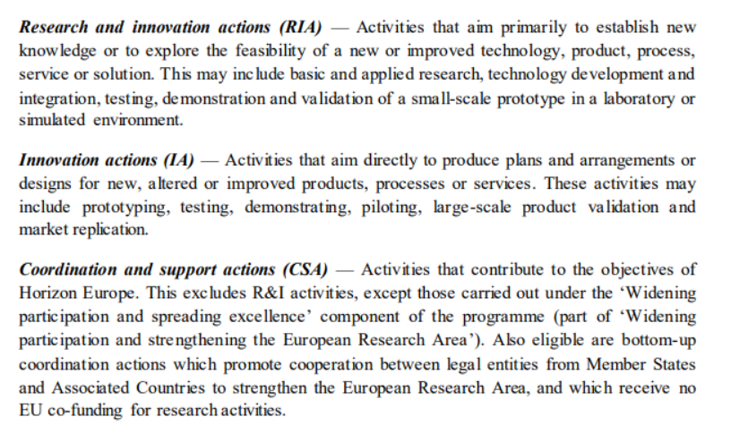
CALLS LEGEND - RDI maturity
RIA
IA
CSA

Slide 10
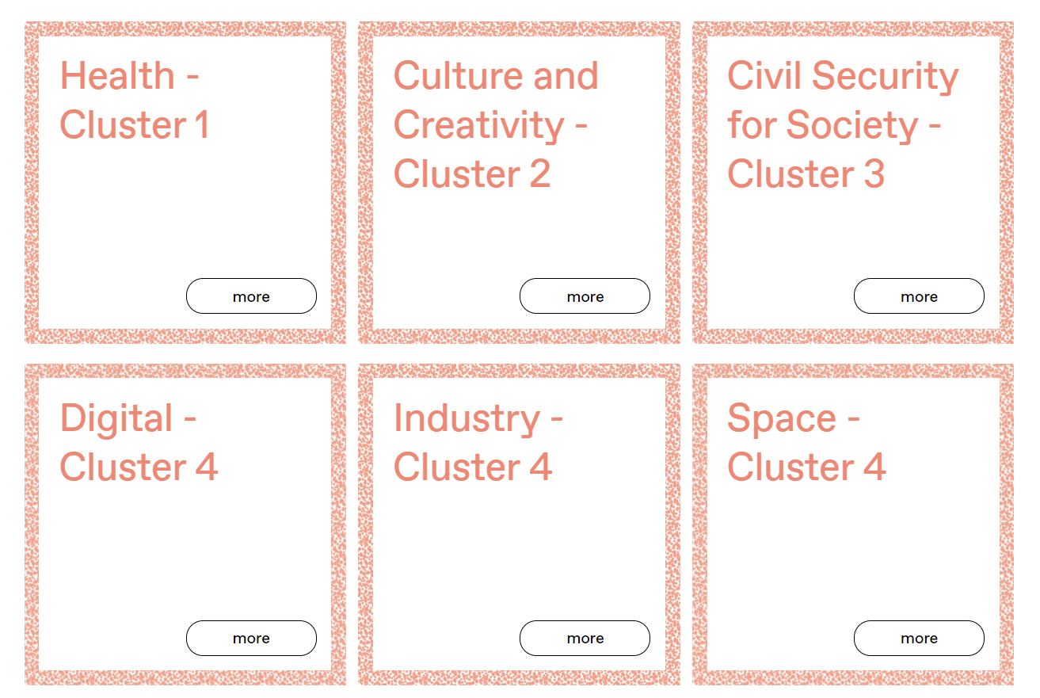
HORIZON EUROPE DIRECT CALLS
https://ec.europa.eu/info/funding-tenders/opportunities/portal/screen/home
https://www.euresearch.ch/en/our-services/inform/open-calls-137.html
Source: EURESEARCH funded by the State Secretariat for Education, Research and Innovation SERI, Switzerland
Partnership proposals – usually minimum 3 partners from 2/3 different countries

Slide 11
HORIZON EUROPE – Research, Development & Innovation

Slide 12
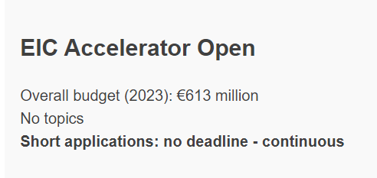
EIC - European Innovation Council
1.13 bil EURO
ACCELERATOR
https://eic.ec.europa.eu/eic-funding-opportunities/eic-accelerator-0_en
grant funding (non-dilutive) of up to €2.5 million for innovation development costs, including demonstration of the technology in the relevant environment, prototyping and system level demonstration, R&D and testing required to meet regulatory and standardisation requirements, intellectual property management, and marketing approval (e.g. at least TRL 5/6 to 8).
investments (direct equity investments or quasi-equity such as convertible loans) of up to €15 million managed by the EIC Fund for scale up and other relevant costs. Companies working on technologies of strategic European interest can apply for EIC investments of more than €15 million.
Disruptive
Start-Ups / SMEs
5-page proposal + max 10 slides pitch deck + 3 min video
GO – full proposal (template)
next cut-off date: 8/10/2024
Link to the Short application open call 2024
Deadline – 24/12/2024

Slide 13
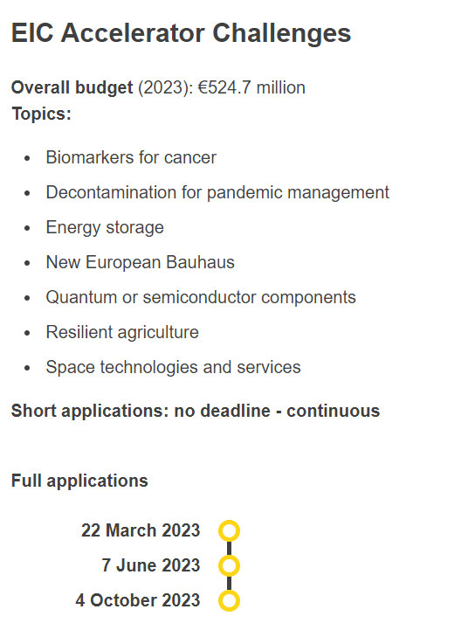
EIC - European Innovation Council
1.13 bil EURO
ACCELERATOR
Disruptive
Start-Ups / SMEs
2024
EIC Accelerator Challenges
2024 Budget: EUR 300 mil
Topics [50 mil/ each] :
Human Centric Generative AI made in Europe
Enabling virtual worlds and augmented interaction in high-impact applications to support the realisation of Industry 5.0
Enabling the smart edge and quantum technology components
Food from precision fermentation and algae
Monoclonal antibody-based therapeutics for new variants of emerging viruses
Renewable energy sources and their whole value chain
2023
https://eic.ec.europa.eu/eic-funding-opportunities/eic-accelerator/eic-accelerator-challenges_en

Slide 14
EIC - European Innovation Council
TRANSITION
https://eic.ec.europa.eu/eic-funding-opportunities/eic-transition_en
The EIC Transition is a funding programme under Horizon Europe targeting innovation activities that goes beyond the experimental proof of principle in laboratory. It supports both the maturation and validation of novel technologies from the lab to the relevant application environments.
Mature a novel technology and develop a business case to bring it to market
Grants of up to €2.5 million are available to validate and demonstrate technology in application-relevant environment and develop market readiness.
Technology validation and spin-out
Validate technologies and develop business plans for specific applications (TRL 3-6).
For SMEs and organisations
Single applicants (SMEs, spin-offs, start-ups, research organisations, universities)
small consortia (minimum 2, maximum 5 eligible entities).
EIC Transition Open - continuous
Strategic EIC Transition Challenges (former in 2023):
  Full scale Micro-Nano-Bio devices for medical
  and medical research applications
  Environmental intelligence
  Chip-scale optical frequency combs

Slide 15
EIC - European Innovation Council
PATHFINDER
https://eic.ec.europa.eu/eic-funding-opportunities/eic-pathfinder_en
EIC Pathfinder Open provides funding for projects in any field of science or technology, based on high-risk/high-gain science-towards-technology breakthrough interdisciplinary research. [ 3 mil EUR]
Support to research teams to research or develop an emerging breakthrough technology
2023 EIC Pathfinder Challenges
Clean and efficient cooling
Architecture, Engineering and Construction digitalisation for a novel triad of design, fabrication, and materials
Precision nutrition
Responsible electronics
In-space solar energy harvesting for innovative space applications
Total budget for the call: EUR 163.5 million;
2024 EIC Pathfinder Challenges
”Solar-to-X” devices
Towards cement and concrete as a carbon sink
Nature inspired alternatives for food packaging and films for agriculture
Nanoelectronics for energy-efficient smart edge devices
Strengthening the sustainability and resilience of EU space infrastructure

Slide 16
EIC – Booster Scheme
https://ec.europa.eu/info/funding-tenders/opportunities/portal/screen/opportunities/topic-details/horizon-eic-2024-booster
Financial Support under the EIC Booster Grant Scheme
HORIZON-EIC-2024-BOOSTER
Deadline: 17/04/2024
The project implementing this action must provide financial support in the form of grants of a fixed maximum amount not exceeding EUR 50 000 to a booster grant project linked to an EIC pathfinder or EIC transition funded projects.

Slide 17
HORIZON EIE – European Innovation Ecosystem
INTERRCONNECTED INNOVATION ECOSYSTEMS
Startup Europe - eg:(HORIZON-EIE-2024-CONNECT-01-02) – Deadline 25/04.24
Scaleup Europe
https://research-and-innovation.ec.europa.eu/funding/funding-opportunities/funding-programmes-and-open-calls/horizon-europe/european-innovation-ecosystems_en

Slide 18
HORIZON EUROPE – Research, Development & Innovation

Slide 19
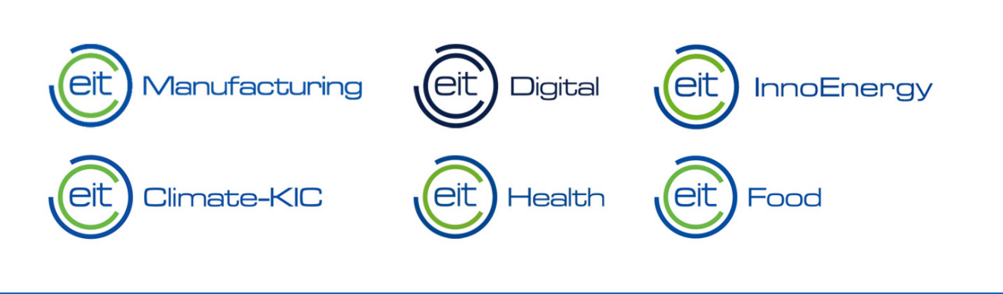




European Institute of Innovation and Technology
Knowledge and Innovation Communities
KIC EIT
MAKING INNOVATION HAPPEN!
https://eit.europa.eu/news-events/news/eic-eit-working-closer-together-europes-innovators

Slide 20


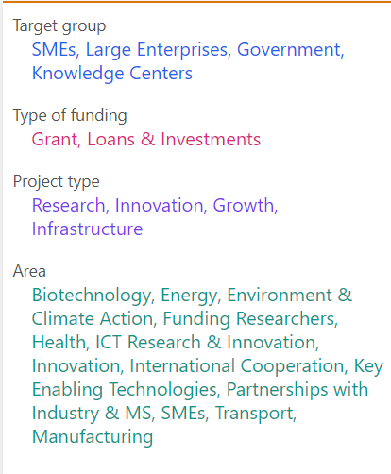
HORIZON
Key Digital Technologies
Joint Undertaking (KDT JU)
(KDT JU) is a public-private partnership managing a research and innovation programme aiming to reinforce the EU’s strategic autonomy in the electronic components and systems sector.
Other organisations include bodies set up as part of EU programmes and public-private partnerships between the European Commission and the industry.
https://www.chips-ju.europa.eu/
The KDT JU funds projects to ensure the EU has the necessary expertise in key enabling technologies to be a competitive leader of the world’s digital economy. This includes developing advanced semiconductors and applications that are critical to European society and contribute to the EU digital strategy and the European Green Deal. KDT JU funded projects provide smart solutions for:
*Mobility *Healthcare *Environment
*Energy *Digital society *Manufacturing
https://european-union.europa.eu/institutions-law-budget/institutions-and-bodies/search-all-eu-institutions-and-bodies/chips-joint-undertaking_en

Slide 21
DIGITAL EUROPE DIRECT CALLS
WORK PROGRAMMES
1. WP - network of European Digital Innovation Hubs - under direct management by the European Commission + national cofinancing
2). High Performance Computing - implemented under indirect management by the Euro HPC JU
3) Data, AI, Cloud, Quantum Communication Infrastructure, advanced digital Skills and deployment activities for the best use of these technologies
4). Cybersecurity - implemented under indirect management by the Cybersecurity Industrial, Technology and Research Competence Centre and the Network of National Coordination Centres.
5 AREAS:
Supercomputing
artificial intelligence
Cybersecurity
advanced digital skills
ensuring the wide use of digital technologies across the economy and society.
..rather for facilitators (gov, digital/innovation agencies, EDIHS, clusters) than for direct SMEs
2 eg. of open calls:
Girls and Women in Digital
DIGITAL-2024-ADVANCED-SKILLS-06-WOMEN
EU AI Innovation Accelerator preparatory action - DIGITAL-2024-AI-ACT-06-INNOV
https://digital-strategy.ec.europa.eu/en/activities/digital-programme

Slide 22
INNOVATION FUND DIRECT CALLS
The Innovation Fund is one of the world’s largest funding programmes for the deployment of net-zero and innovative technologies.
The Innovation Fund aims to:
help businesses invest in clean energy and industry
boost economic growth
create future-proof jobs
reinforce European technological leadership on a global scale.
Link to direct calls
Innovation Fund 2023 Net Zero Technologies – Manufacturing –
This topic supports projects for manufacturing innovative clean-tech components for hydrogen production/consumption, renewable energy and energy storage.
Construction and operation of manufacturing facilities to produce specific components for:
A. renewable energy installations (in photovoltaics, concentrated solar power, on-shore and offshore wind power, ocean energy, geothermal, solar thermal, and others), including their connection to the electricity/heat grid
B. electrolysers and fuel cells
C. energy storage solutions covering both batteries and other storage solutions for stationary and mobile use for intra-day and long duration storage
D. heat pumps.
Only projects with a total capital expenditure above EUR 2,5 mil are eligible under this topic.
Open call eg.:
Innovation Fund 2023 Net Zero Technologies – General decarbonisation – Small-Scale Projects
INNOVFUND-2023-NZT-GENERAL-SSP

Slide 23
SINGLE MARKET (SMP)
DIRECT CALLS
The Single Market Programme covers the following 6 objectives:
Food safety
Consumer protection
Support to businesses
  Enterprise Europe Network
  SME envoy network SME-friendly regulation and policy-making at EU and national level
  Erasmus for Young Entrepreneurs
  Joint cluster initiatives: EUROCLUSTERS, European Cluster Partnerships, ECCP, Cluster mapping, ClusterXchange, Advances technologies for industry, S3P Industry Partnerships
  other actions implementing the EU SME strategy
A more effective single market
Supporting the development of standards and reporting
Producing and disseminating high quality European statistics
Usually addressed to SME support entities, facilitators
SMEs & large companies also eligible – but with role of facilitators
ENTERPRISE EUROPE NETWORK
EUROCLUSTERS
TOURISM boost

Slide 24
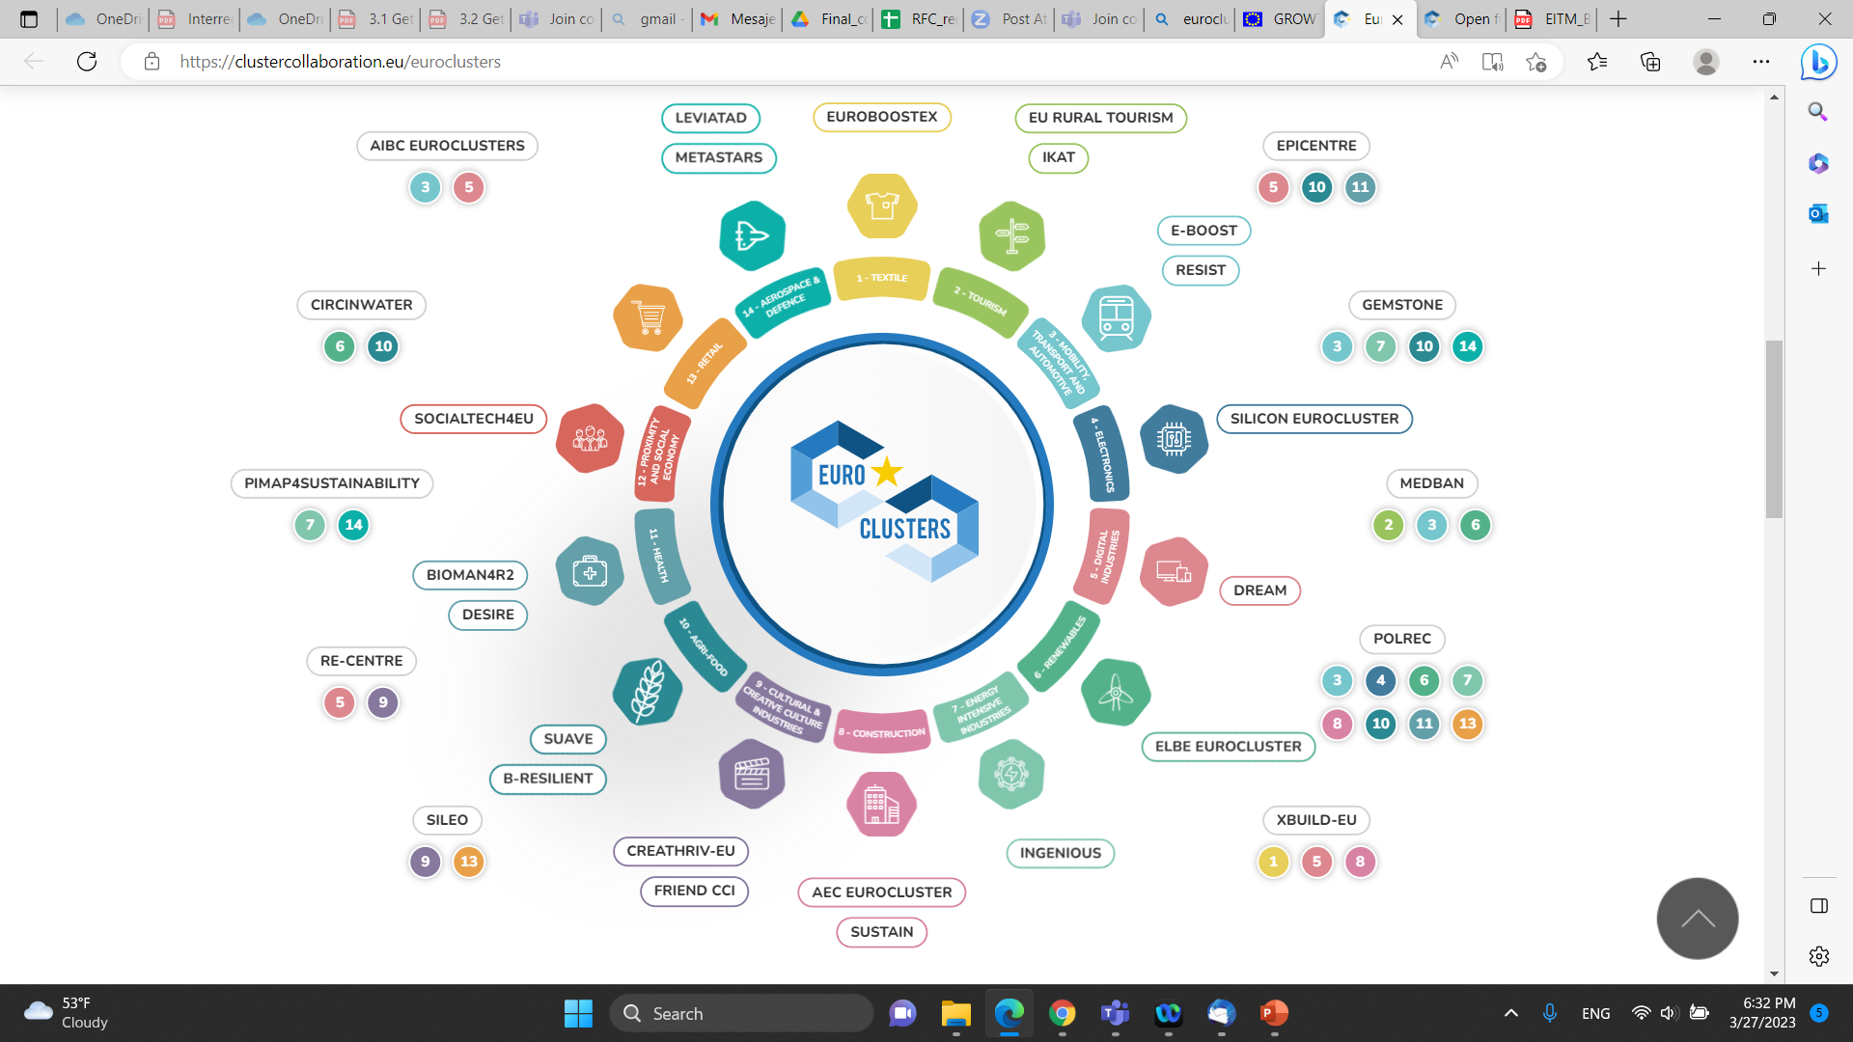
EURCLUSTERS 2022-2024 – Single Market ogram
€42 million from the Single Market Programme have been allocated to this first batch of Euroclusters, composed of 171 partners, covering 23 different countries and all 14 industrial ecosystems.
20 Euroclusters from specific industrial ecosystems
10 Euroclusters across several industrial ecosystems.
Next call – to be announced during 2024

Slide 25
CASCADE FUNDING
CALLS
MAIN Sources:
..most proper for SMEs and startups
https://ec.europa.eu/info/funding-tenders/opportunities/portal/screen/opportunities/competitive-calls
F&T Portal – HORIZON EUROPE cascade funding calls
F&T Portal – SINGLE MARKET cascade funding calls
F&T Portal – DIGITAL EUROPE cascade funding calls
F&T Portal – Innovation Fund cascade funding calls
European Cluster Collaboration Platform: https://clustercollaboration.eu/open-calls

Slide 26
I3 – Interregional Innovation Investments
Capacity Building Strand 2b (I3-2023-CAP2b)
Regional Innovation Valleys calls for proposal
  Interregional Innovation Investments Strand 1 call document
  Interregional Innovation Investments Strand 2a call document
https://eismea.ec.europa.eu/programmes/interregional-innovation-investments-i3-instrument_en

Slide 27
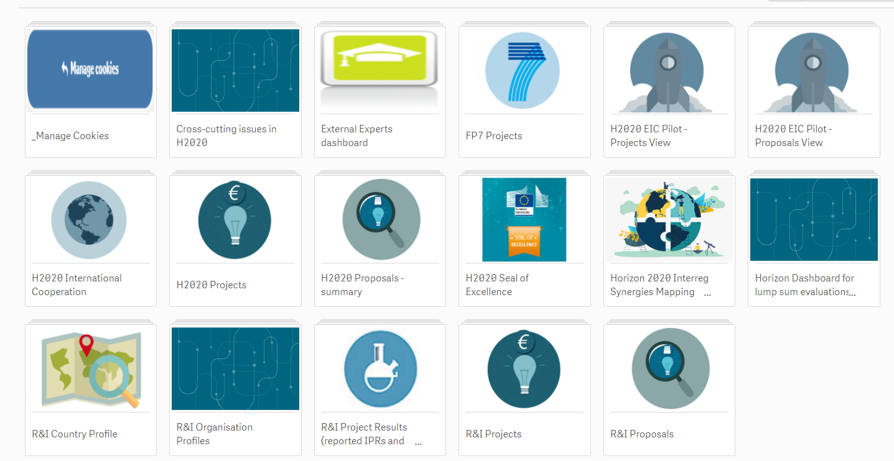

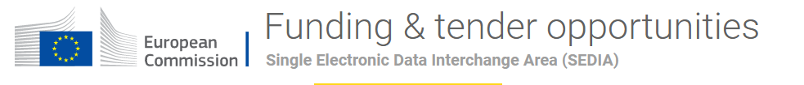
https://mind4machines.eu/open-innovation-platform/
PARTNER SEARCH
https://webgate.ec.europa.eu/dashboard/hub
https://ec.europa.eu/info/funding-tenders/opportunities/portal/screen/how-to-participate/partner-search
https://een.ec.europa.eu/partnering-opportunities
+ Partner Search chapter after each published open call

Slide 28
EBAN Congress for Startups TALLINN - Startups 2024 | EBAN Congress – 20-22/05/24; 15/04 pitch deadline
HTVD – Hightech Venture Days :
  USA Washington DC – 7-8/05/24
  Germany Dresda – 8-8/10/24
MWC Las Vegas – 8-10/10/24
Techsylvania (RO - CJ) – 26-67/06/204
Private Investment Strategy
WEBINAR – 1 h – available to the MIND4MACHINES Acceleration Programme intranet website
LIST of upcoming Investors & StartUps Pitching Events
F6S Platform: https://www.f6s.com/programs

Slide 29
Infos on Coaching
Coaching Session on Public Funding, Private Investment Strategy
and the necessary steps to access European funds
Winner
Need Assessment
& Check
Precondition for the selection of the coaching sessions is the completed need assessment form. (1. Mentoring Session)
Doodle
booking
Visit the Doodle booking pages and make a booking request for each of your assigned coaching sessions.
Required
booking data
Request your coaching session: coaching topic – coaching session - coach name >> selection of date and timeslot
The selection of the coaching sessions was compared with the needs of all beneficiaries and allocated according to established criteria for this proceeding.
Beneficiaries will be notified by email of their allocated coaching sessions and redirected to the Coaching Request Area
on MIND4MACHINES Website. Link: https://mind4machines.eu/accelerator-program/accelerator-profgramme-private-area/coaching-2/
The coach will be informed of your request and confirm your appointment by doodle notification.
You will receive an appointment invitation and information about the preparation and further procedure for the coaching
(Further communication takes place by email)
Persomal information: Please use your acronym as the name and the e-mail address of one contact person.
Please use the same data for each request!
Mentors
M4M-Team
Winner
Coach
Winner

Slide 30
Coaching Sessions slots
Public Funding
Private Investment Strategy
10:00-11:00 CET
Monday, 18.03
Wednesday, 20.03
Friday, 22.03
Monday, 25.03
Wednesday, 27.03

Slide 31
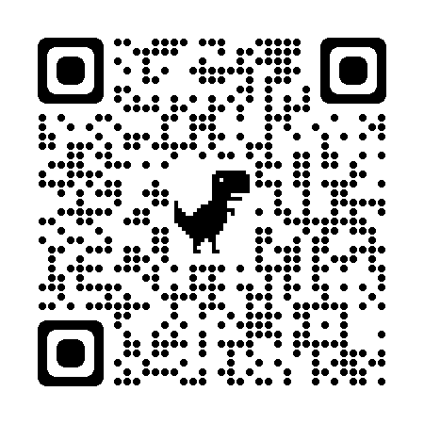
We appreciate your feedback!
https://forms.office.com/e/Q7AVjJQkCq
Thanks
Expert for Public Funding
Ioana Dragos
LinkedIn: https://twitter.com/ioanaadrnv
Expert for Private Funding
Cristian Dascalu
LinkedIn: https://www.linkedin.com/in/cristiandascalu
Further Information on the Accelerator Services:
Available for Beneficiaries and IRL-Applicants
https://mind4machines.eu/accelerator-program/

